Slide 1


Authentication for Droids These are the droids you are looking for Tim Messerschmidt @SeraAndroid

Slide 2
Developer Evangelist

Slide 3
Why am I here?
Notes:
We’re having a mobile first approach where we push our products
PayPal is opening up to technology and developers

Slide 4
Rebuilding the Developer Experience:
developer.paypal.com

Slide 5

Notes:
There is no way to better explain anything than using Lego and Ninjas
Pic: http://www.flickr.com/photos/mac_filko/5471023503/

Slide 6
Do we always use the same identity?

Slide 7
Should we always use the same identity?

Slide 8
Authentication vs.
Authorization
Notes:
Authorization first
Do we always need to have site-specific passwords?

Slide 9
Current standards

Slide 10
Basic Authentication
username:password
Notes:
Passed as header in the requests
encoded as Base64

Slide 11
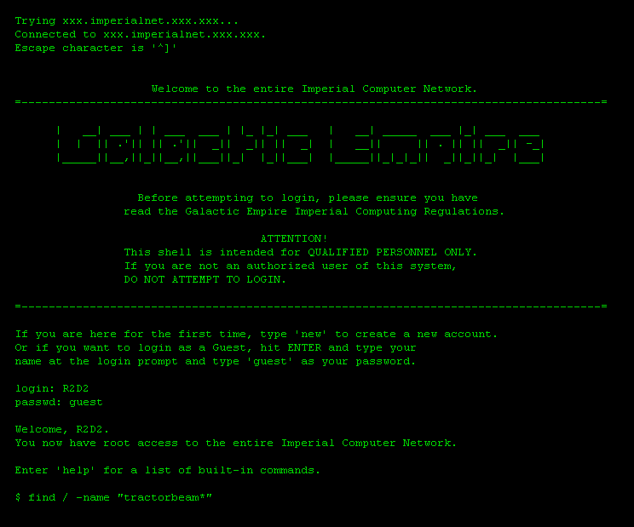
Notes:
http://abstrusegoose.com/262

Slide 12
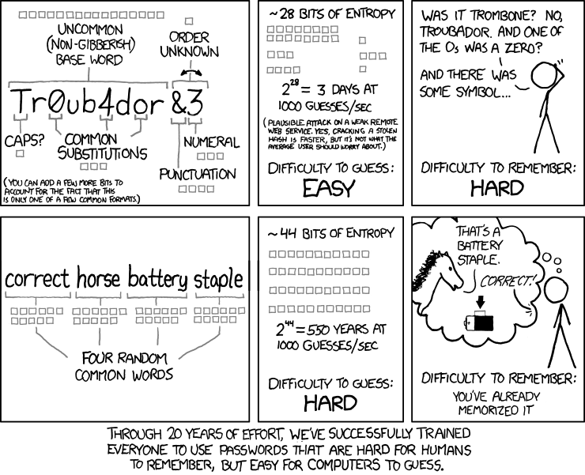
Notes:
http://abstrusegoose.com/262

Slide 13
Passwords
wiki.scullsecurity.org/Passwords
Notes:
Passed as header in the requests
encoded as Base64

Slide 14
Security Nightmare
4.7% of users have the password password
8.5% have the passwords password or 123456
9.8% have the passwords password, 123456, 12345678
14% have a password from the top 10 passwords
40% have a password from the top 100 passwords
79% have a password from the top 500 passwords
91% have a password from the top 1000 passwords
Notes:
Password storage
SharedPreferences
SQLite Cipher

Slide 15
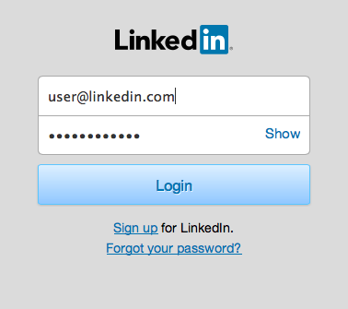
Allow your users to see
their input
Notes:
http://www.nngroup.com/articles/stop-password-masking/
Jakob Nielsen 2009

Slide 16
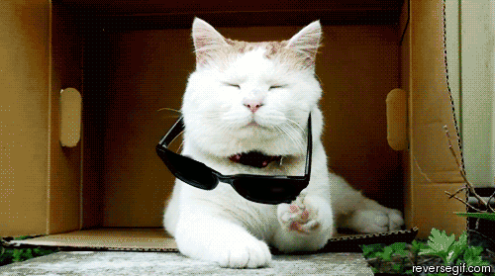

Slide 17
OAuth 1.0
Notes:
Final Draft 2007
Eran Hammer
Twitter, Yahoo, Google

Slide 18


Slide 19
Consumer
Service Provider
Request
Request Token
Grant
Request Token
Direct User to Service
Obtain Authorization
Request
Access Token
Direct to Consumer
Access
Resources
Grant
Access Token
Notes:
Request Token
Access Token

Slide 20
OAuth 1.0a
Notes:
2009 Possible man-in-the-middle attack
Redirect url moved from step 2 to 1

Slide 21
Signpost <3
github.com/mttkay/signpost
Notes:
Matthias Käppler
Qype / SoundCloud

Slide 22
OAuth 2.0
Notes:
Focus on simplicity and different scenarios
Main framework published in 2012
Bearer token

Slide 23
Consumer
Service Provider
Direct User to Service
Obtain Authorization
Request
Access Token
Grant
Access Token
Access
Resources / Profile
Direct to Consumer
Notes:
Authorization code
Access token
Refresh token

Slide 24
HTTP Header
URL url = new URL(”http://url.com/”);
HttpURLConnection urlConnection =
(HttpURLConnection) url.openConnection();
setRequestProperty(”Authorization”, ”Bearer …”);
URI parameter
“url.com/oauth?access_token=…”

Slide 25
Scribe
github.com/fernandezpablo85/scribe
PostmanLib
github.com/fedepaol/PostmanLib--Rings-Twice--Android

Slide 26
OAuth 2.0 and the Road to Hell
http://hueniverse.com/2012/07/oauth-2-0-and-the-road-to-hell/
Notes:
Eran Hammer discusses disadvantages of OAuth 2.0
Blueprint for an authorization protocol

Slide 27
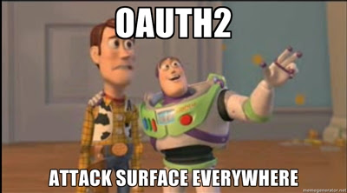
http://homakov.blogspot.de/2013/03/oauth1-oauth2-oauth.html
Notes:
Security flaws that need to be solved in the implementation
Egor Homakov

Slide 28
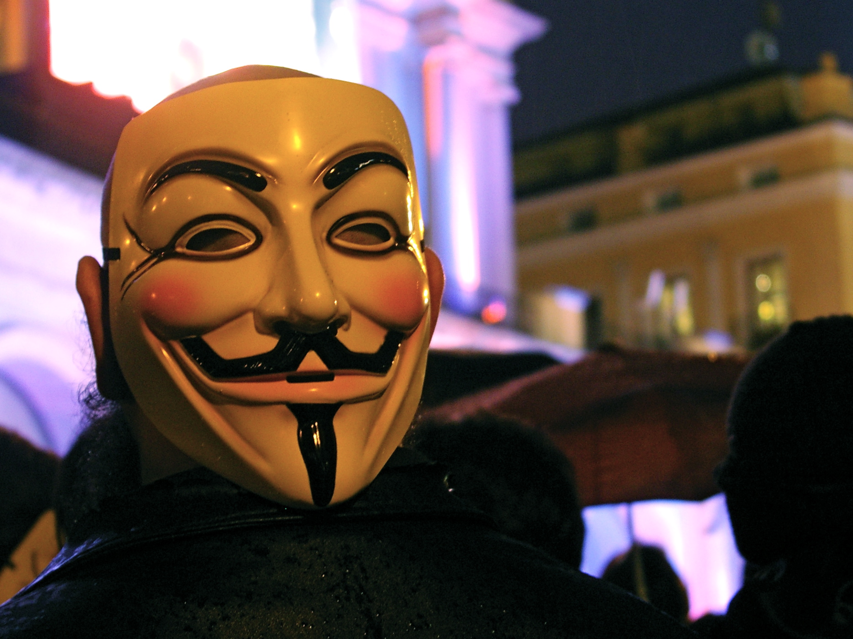
Notes:
This is about proving that it’s actually me
http://www.flickr.com/photos/gaelx/5445598436

Slide 29
Name
Date of Birth
Creation Date
Email
Language
Locale
Gender
Time Zone
Phone Number
Address
Notes:
To name just a few interesting pieces of information
Definition via scopes which can be static or dynamic

Slide 30
OpenID
Notes:
Developed in 2005
2012 Authentication bug hijacking
MyOpenID.com to shut down in 2014 (JanRain)

Slide 31
BrowserID
Persona
Notes:
Launched 2011
Pushed via Mozilla
Identity Bridging in 2013 (via Gmail, ..)

Slide 32
How to combine both?

Slide 33
OpenID with OAuth Hybrid Extension
Notes:
Provides identity and grants access to resources
Draft in 2009
Uses OAuth 1.0

Slide 34
OpenID Connect
Notes:
Identity layer on top of OAuth 2.0
Access profile information in a REST-friendly way
Currently still a draft
Session management

Slide 35
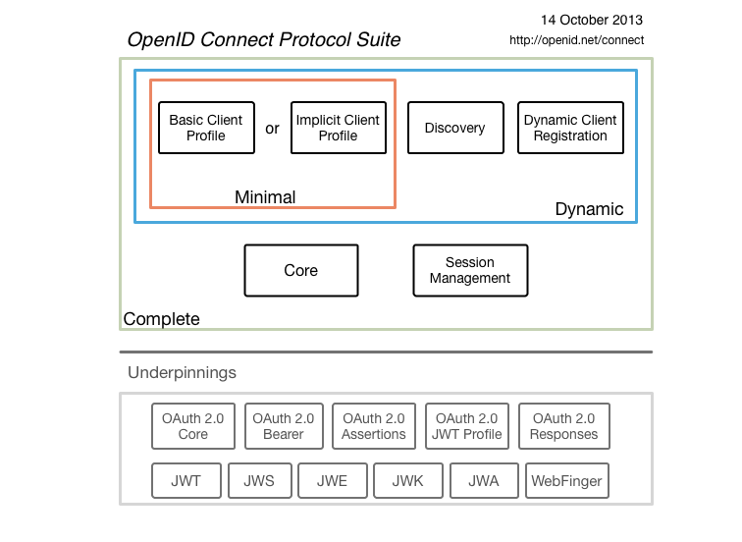

Slide 36
Identity Providers
Social vs. Concrete
Notes:
Social connects to my friends and shows interests
Concrete pulls real data

Slide 37




Slide 38


Slide 39
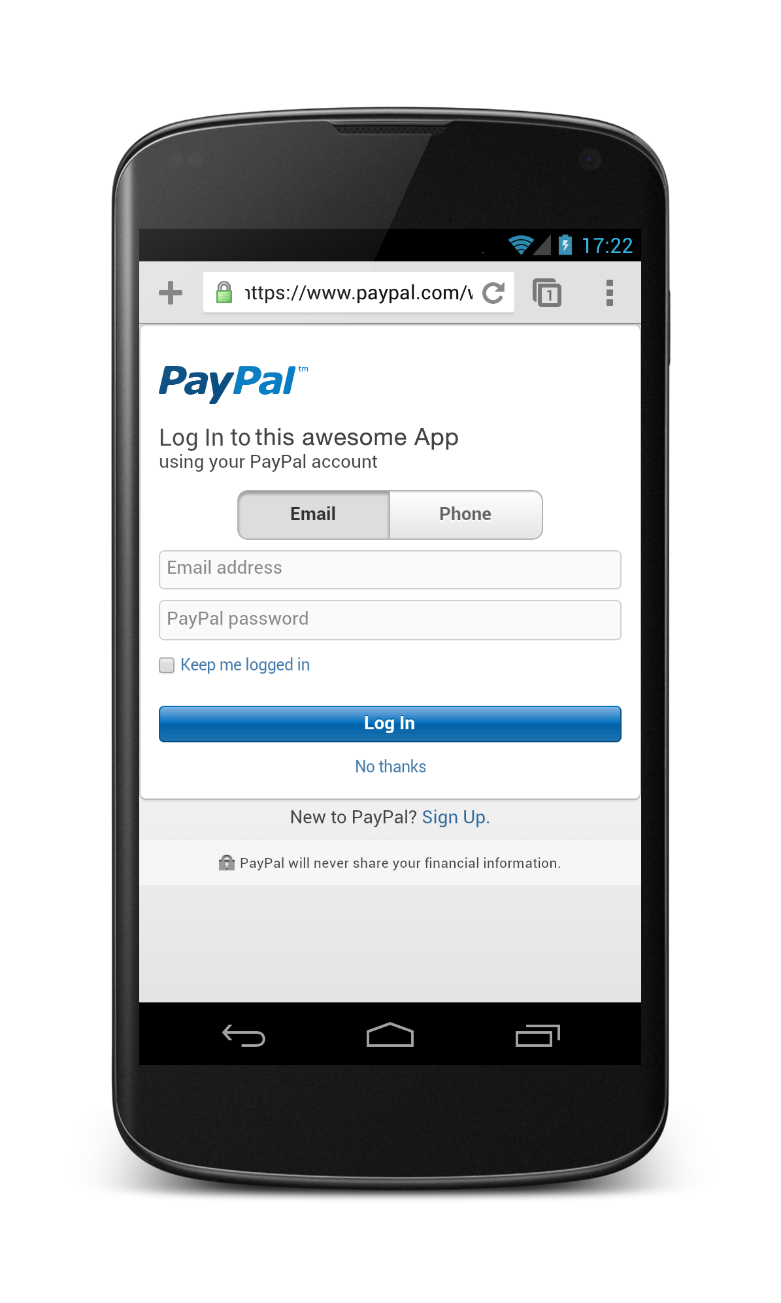
Log in via PayPal in the browser or a WebView.

Slide 40
Yeah, nice.. but why?
People forget passwords…
45% admit to leaving a website instead of re-setting their password or answering security questions *
* Blue Inc. 2011
Notes:
Source: http://www.shop.org/sites/default/files/janrain_-_consumer_perceptions_of_online_registration_social_sign_in_0.pdf

Slide 41
Also they hate to register
Out of 657 surveyed users 66% think that social sign-in is a desirable alternative. *
* Blue Inc. 2011

Slide 42

Notes:
Don‘t use identity as barrier
Don‘t force users into it
Picture: http://www.flickr.com/photos/pagedooley/5313215496

Slide 43
Wrap up
Identity does matter to users and developers
Difference between authentication and authorization
User Experience should be enhanced not impaired

Slide 44
Questions? tmesserschmidt@paypal.com @SeraAndroid slideshare.com/paypal

